Slide 1
Classification by Back propagation
  Backpropagation is a neural network learning algorithm.
  Neural network is a set of connected input/output units in which each connection has a weight associated with it.
  During the learning phase, the network learns by adjusting the weights so as to be able to predict the correct class label of the input tuples.

Slide 2
Issues
  Neural networks involve long training times and are therefore more suitable for applications where this is feasible.
  They require a number of parameters that are best determined empirically such as the network topology or “structure.”
  Neural networks have been criticized for their poor interpretability. For example, it is difficult for humans to interpret the symbolic meaning behind the learned weights and of “hidden units” in the network. These features initially made neural networks less desirable for data mining.

Slide 3
Advantages
  High tolerance of noisy data as well as their ability to classify patterns on which they have not been trained.
  They can be used when you may have little knowledge of the relationships between attributes and classes.
  They are well suited for continuous-valued inputs and outputs, unlike most decision tree algorithms.
  They have been successful on a wide array of real-world data, including handwritten character recognition, pathology and laboratory medicine, and training a computer to pronounce English text.

Slide 4
  Neural network algorithms are inherently parallel; parallelization techniques can be used to speed up the computation process.
  In addition, several techniques have been recently developed for rule extraction from trained neural networks.
  These factors contribute to the usefulness of neural networks for classification and numeric prediction in data mining.

Slide 5
A Multilayer Feed-Forward Neural Network
  The back propagation algorithm performs learning on a multilayer feed-forward neural network.
  It iteratively learns a set of weights for prediction of the class label of tuples.
  A multilayer feed-forward neural network consists of an input layer, one or more hidden layers, and an output layer.
  Each layer is made up of units.
  The inputs to the network correspond to the attributes measured for each training tuple.
  The inputs are fed simultaneously into the units making up the input layer.

Slide 6
  These inputs pass through the input layer and are then weighted and fed simultaneously to a second layer of “neuronlike” units, known as a hidden layer.
  The outputs of the hidden layer units can be input to another hidden layer, and so on.
  The number of hidden layers is arbitrary, although in practice, usually only one is used.
  The weighted outputs of the last hidden layer are input to units making up the output layer, which emits the network’s prediction for given tuples.

Slide 7
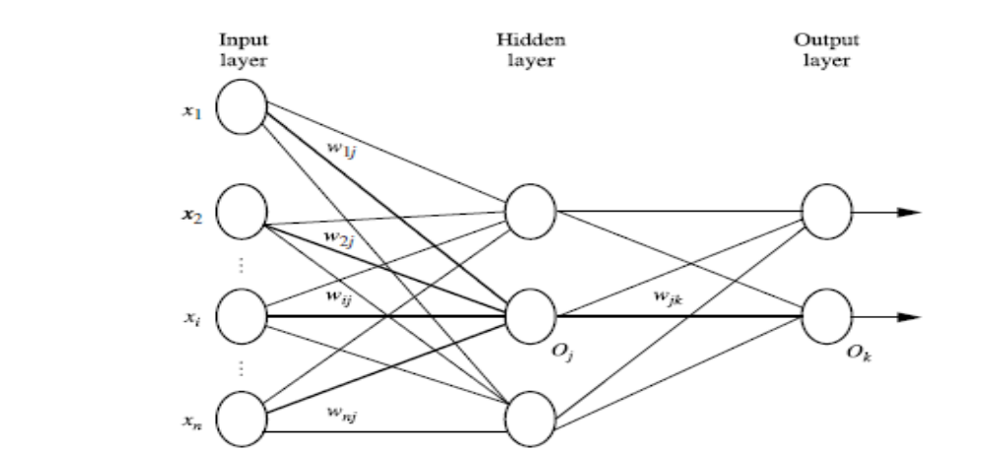
  The units in the input layer are called input units.
  The units in the hidden layers and output layer are sometimes referred to as neurodes, due to their symbolic biological basis, or as output units. Ex: two-layer neural network, three-layer neural network, no loopbacks, fully connected network

Slide 8
  Each output unit takes, as input, a weighted sum of the outputs from units in the previous layer
  It applies a nonlinear (activation) function to the weighted input.
  Multilayer feed-forward neural networks are able to model the class prediction as a nonlinear combination of the inputs.
  From a statistical point of view, they perform nonlinear regression. Multilayer feed-forward networks, given enough hidden units and enough training samples, can closely approximate any function.

Slide 9
Defining a Network Topology
Before training can begin, the user must decide on the network topology by specifying the number of units in the input layer, the number of hidden layers (if more than one), the number of units in each hidden layer, and the number of units in the output layer.
Normalizing the input values for each attribute measured in the training tuples will help speed up the learning phase. values are normalized so as to fall between 0.0 and 1.0.
Discrete-valued attributes may be encoded such that there is one input unit per domain value. For example, if an attribute A has three possible or known values, namely {a0, a1, a2}, then we may assign three input units to represent A. That is, we may have, say, I0, I1, I2 as input units. Each unit is initialized to 0.

Slide 10
Neural networks can be used for both classification (to predict the class label of a given tuple) and numeric prediction (to predict a continuous-valued output).
For classification, one output unit may be used to represent two classes (where the value 1 represents one class, and the value 0 represents the other).
If there are more than two classes, then one output unit per class is used.
There are no clear rules as to the “best” number of hidden layer units. Network design is a trial-and-error process and may affect the accuracy of the resulting trained network.

Slide 11
The initial values of the weights may also affect the resulting accuracy. Once a network has been trained and its accuracy is not considered acceptable, it is common to repeat the training process with a different network topology or a different set of initial weights.
Cross-validation techniques for accuracy estimation can be used to help decide when an acceptable network has been found.

Slide 12
Backpropagation
Back propagation learns by iteratively processing a data set of training tuples, comparing the network’s prediction for each tuple with the actual known target value.
The target value may be the known class label of the training tuple (for classification problems) or a continuous value (for numeric prediction).
For each training tuple, the weights are modified so as to minimize the mean-squared error between the network’s prediction and the actual target value.
These modifications are made in the “backwards” direction (i.e., from the output layer) through each hidden layer down to the first hidden layer. Although it is not guaranteed, in general the weights will eventually converge, and the learning process stops.

Slide 13
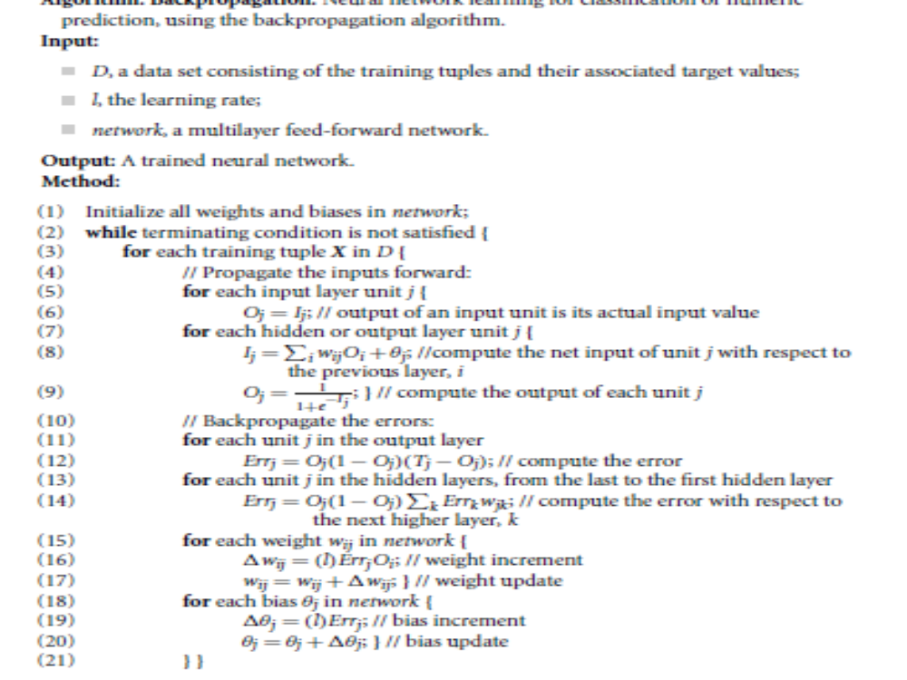

Slide 14
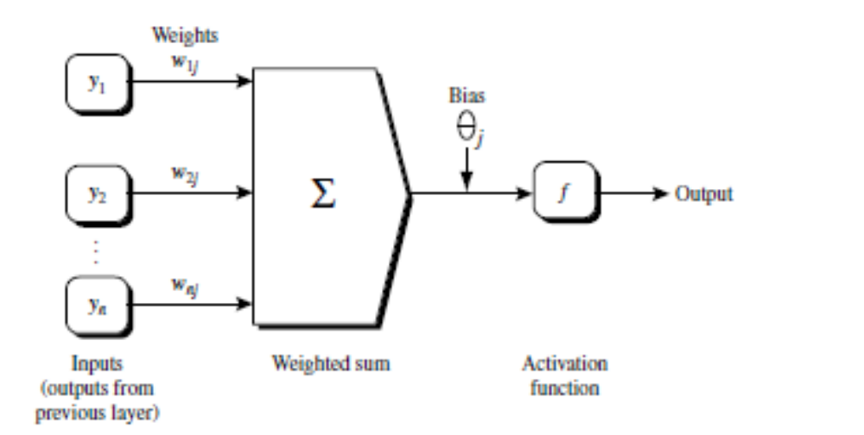

Initialize the weights: The weights in the network are initialized to small random numbers (e.g., ranging from -1.0 to 1.0, or -0.5 to 0.5).
The biases are similarly initialized to small random numbers.
Each training tuple, X, is processed by the following steps.
Propagate the inputs forward:

Slide 15
This function is also referred to as a squashing function, because it maps a large input domain onto the smaller range of 0 to 1.
The logistic function is nonlinear and differentiable, allowing the back propagation algorithm to model classification problems that are linearly inseparable.
We compute the output values, Oj , for each hidden layer, up to and including the output layer, which gives the network’s prediction.
In practice, it is a good idea to cache (i.e., save) the intermediate output values at each unit as they are required again later when back propagating the error. This trick can substantially reduce the amount of computation required.

Slide 16
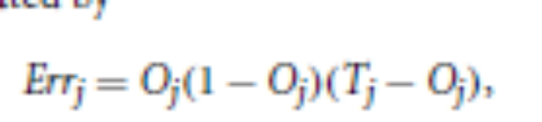
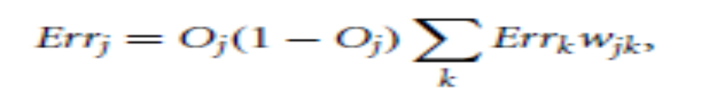
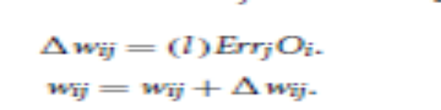
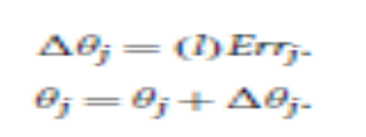
Backpropagate the error:
For a unit j in the output layer, the error Errj is computed by
The error of a hidden layer unit j is
Weights are updated by the following equations, where 1wij is the change in weight wij :
Biases are updated by the following equations,
case updating, epoch updating
Terminating condition: Change in weights, % of misclassification > threshold values, no. of iterations expires.

Slide 17
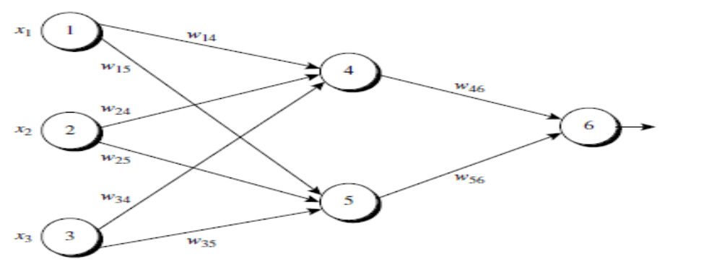
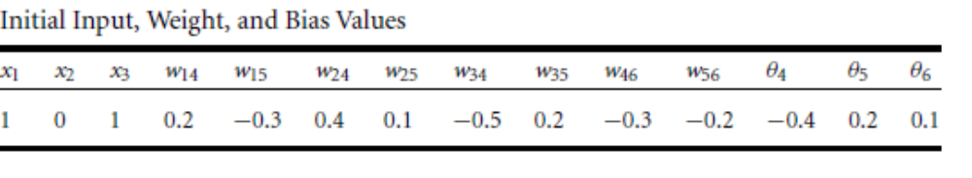
Sample calculations for learning by the back propagation algorithm
Let the learning rate be 0.9. X = {1, 0, 1}, with a class label of 1.

Slide 18
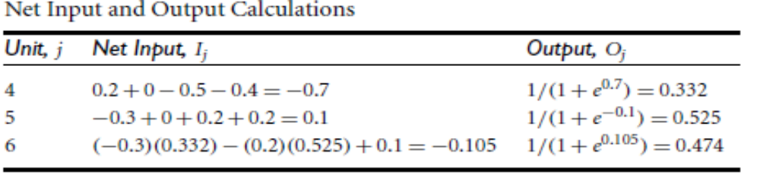
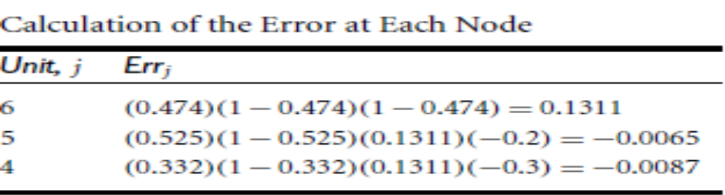

Slide 19
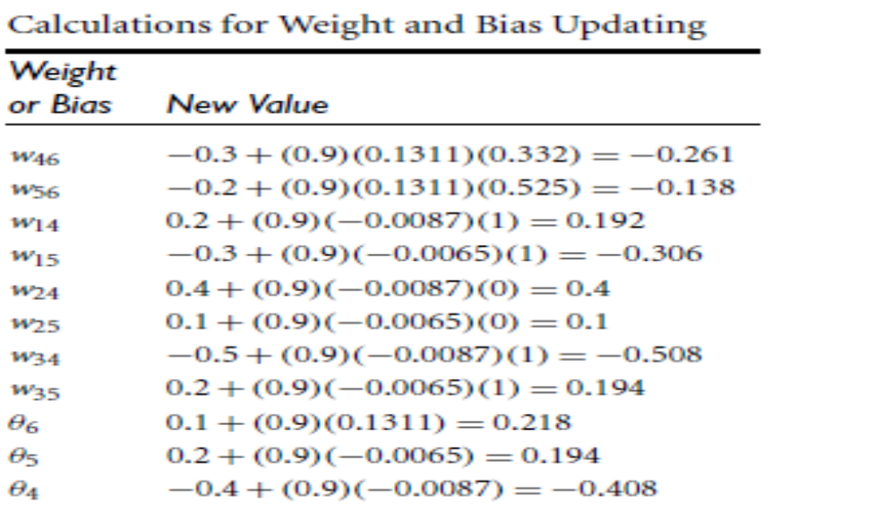

Slide 20
“How can we classify an unknown tuple using a trained network?”
To classify an unknown tuple, X, the tuple is input to the trained network, and the net input and output of each unit are computed. (There is no need for computation and/or back propagation of the error.)
If there is one output node per class, then the output node with the highest value determines the predicted class label for X.
If there is only one output node, then output values > 0.5 may be considered as belonging to the +ve class, otherwise –ve .
Several variations - involve the dynamic adjustment of the topology and of the learning rate or other parameters, or the use of different error functions.

Slide 21
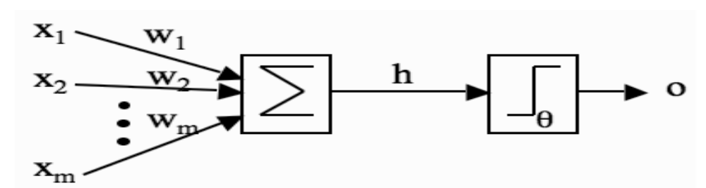
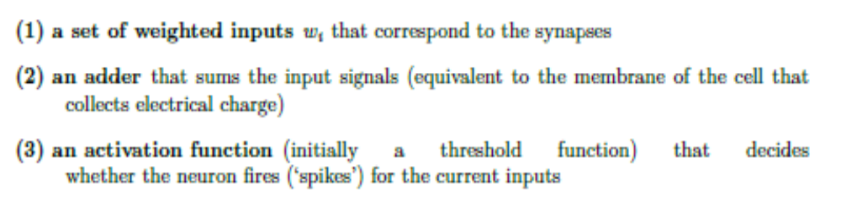
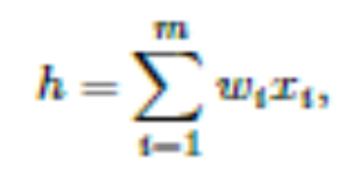
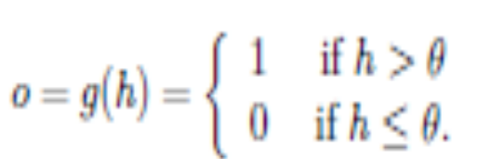
McCulloch and Pitts Neurons

Slide 22
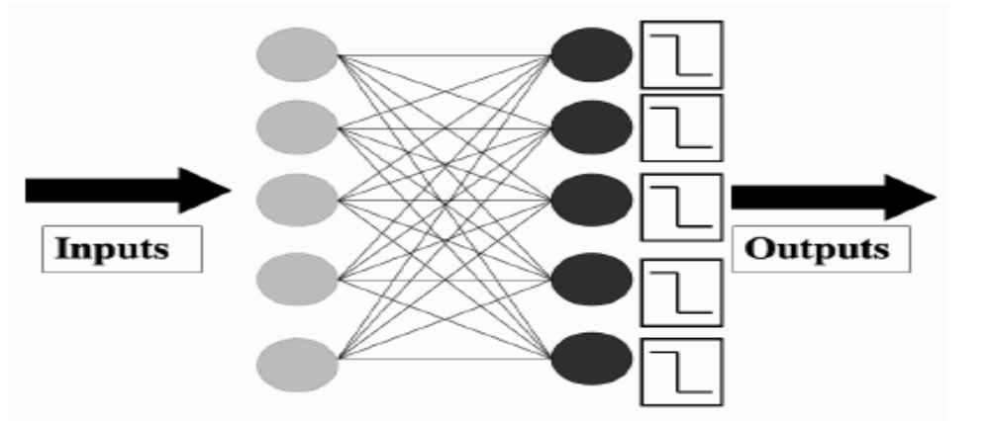

PERCEPTRON
The Perceptron is nothing more than a collection of McCulloch and Pitts neurons together with a set of inputs and some weights to fasten the inputs to the neurons.

Slide 23

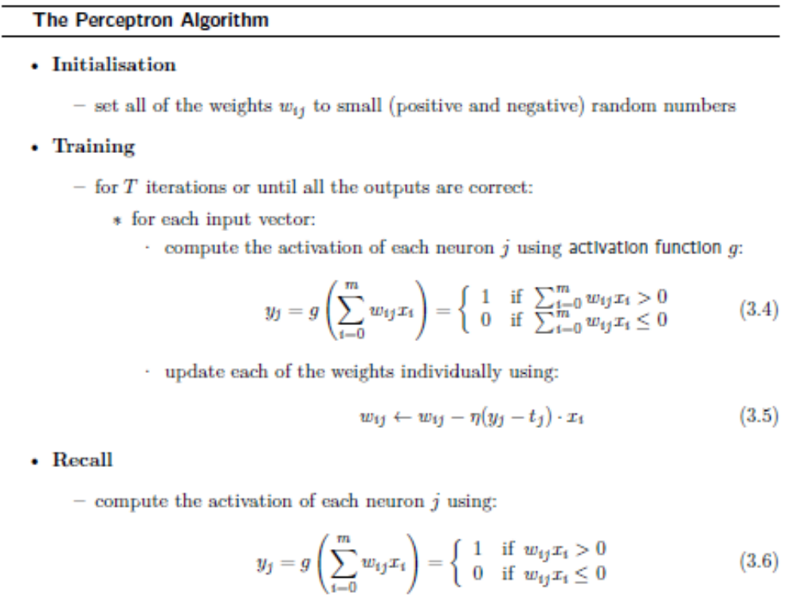

Slide 24
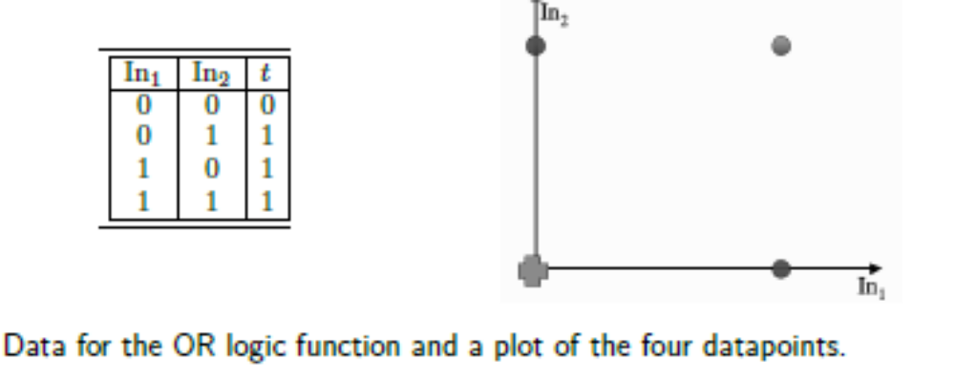
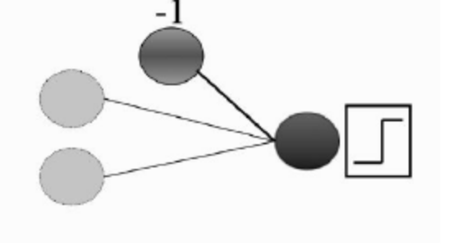
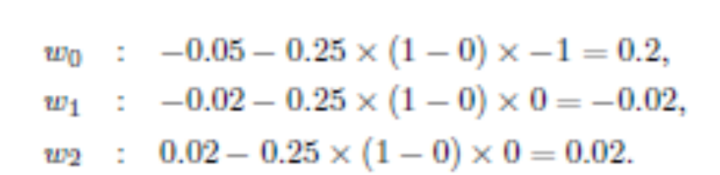


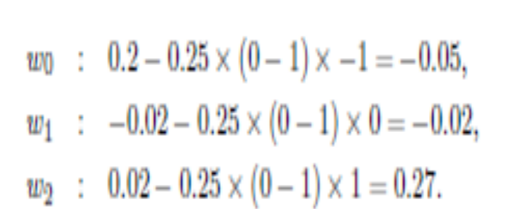
Example
−0.05 × −1 +
−0.02 × 0 + 0.02 × 0 = 0.05.
next input (0, 1) and compute the output
(check that you agree that
the neuron does not fire, but that it should)

Slide 25
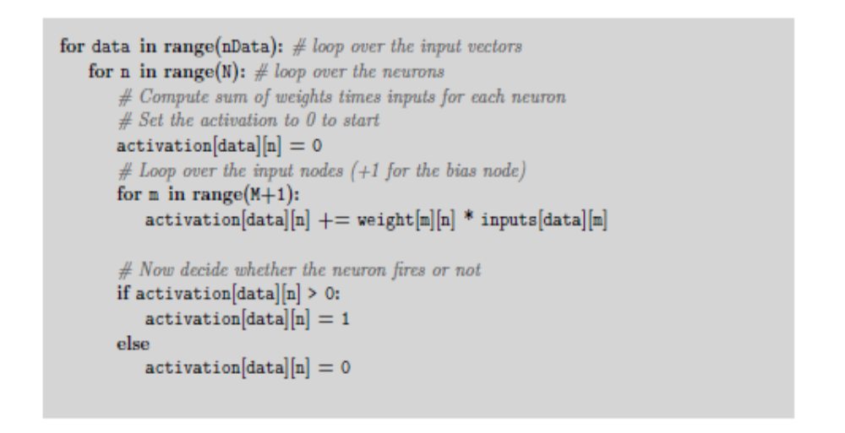
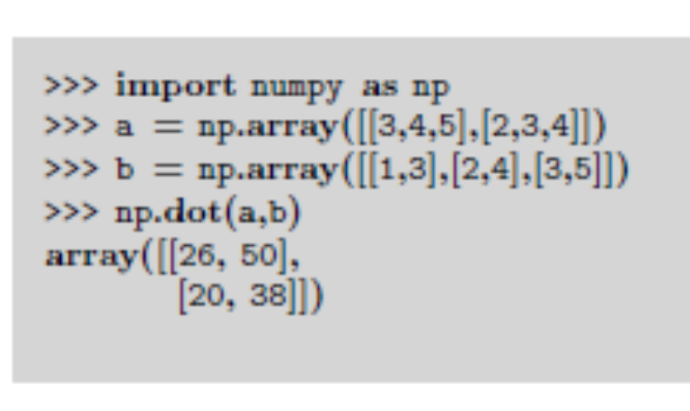
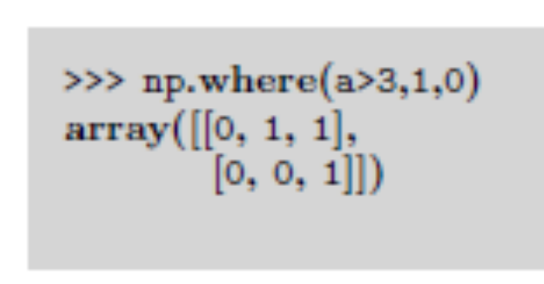
Implementation

Slide 26
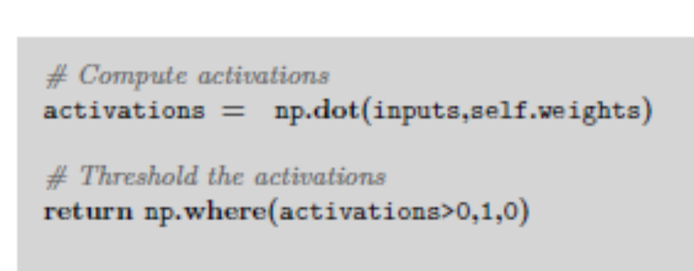
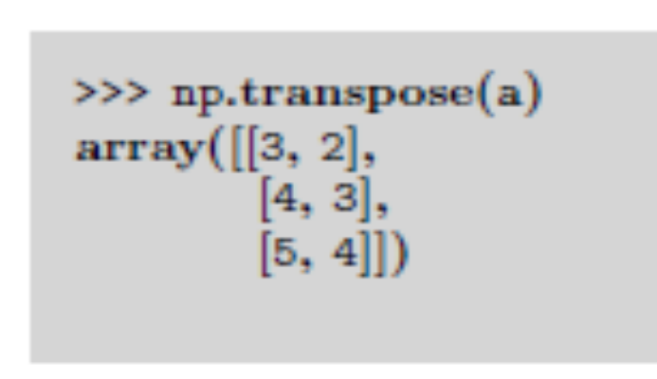

Slide 27
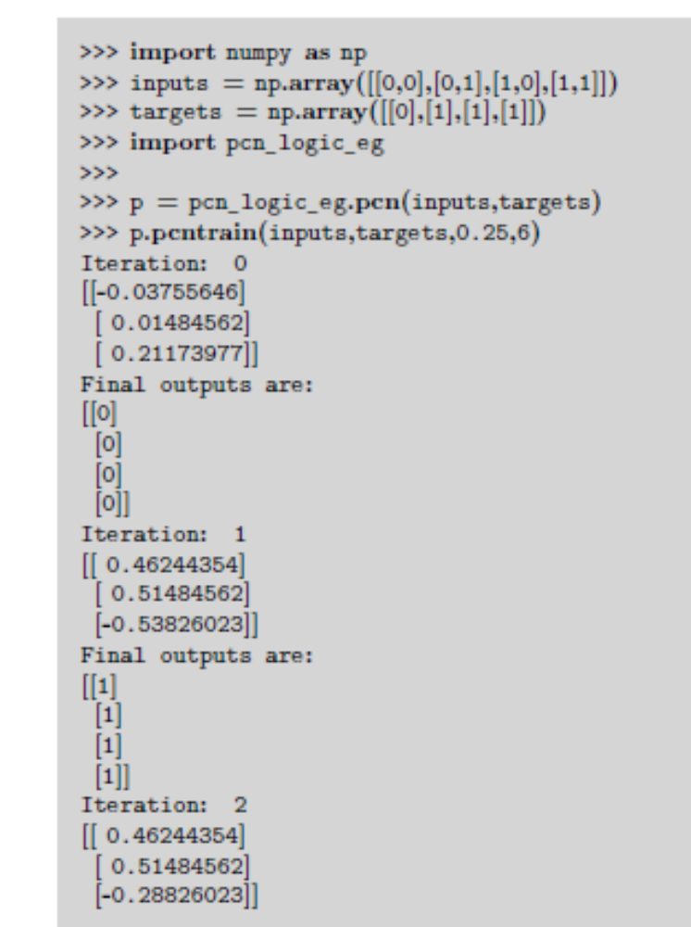
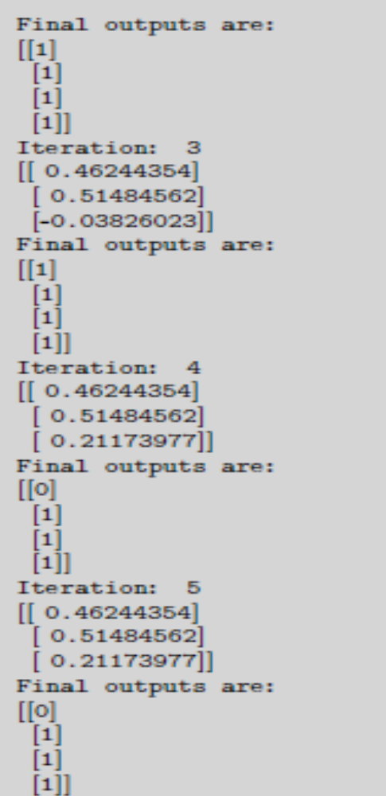

Slide 28

Linearly Separable
Perceptron tries to find a straight line (in 2D, a plane in 3D, and a hyper plane in higher dimensions) where the neuron fires on one side of the line, and doesn’t on the other. This line is called the decision boundary or discriminant function
Consider just one input vector x.
The neuron fires if x·wT > 0 (where w is the row of W that connects the inputs to one particular neuron; they are the same for the OR example, since there is only one neuron, and wT denotes the transpose of w and is used to make both of the vectors into column vectors).
The a · b notation describes the inner or scalar product between two vectors

Slide 29
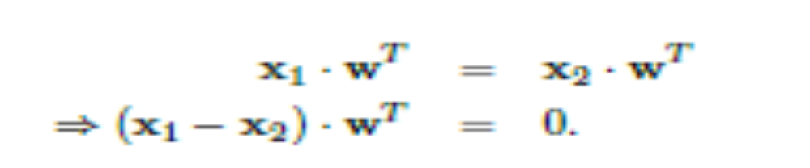
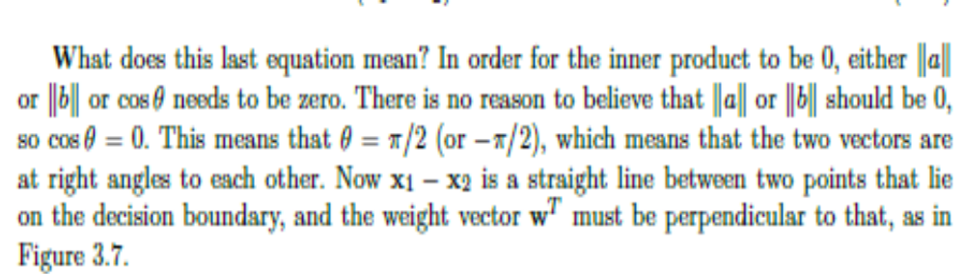
It can be computed in NumPy using the np.inner() function.
Getting back to the Perceptron, the boundary case is where we find an input vector x1 that has x1 · wT = 0. Now suppose that we find another input vector x2 that satisfies
x2 · wT = 0. Putting these two equations together we get:

Slide 30
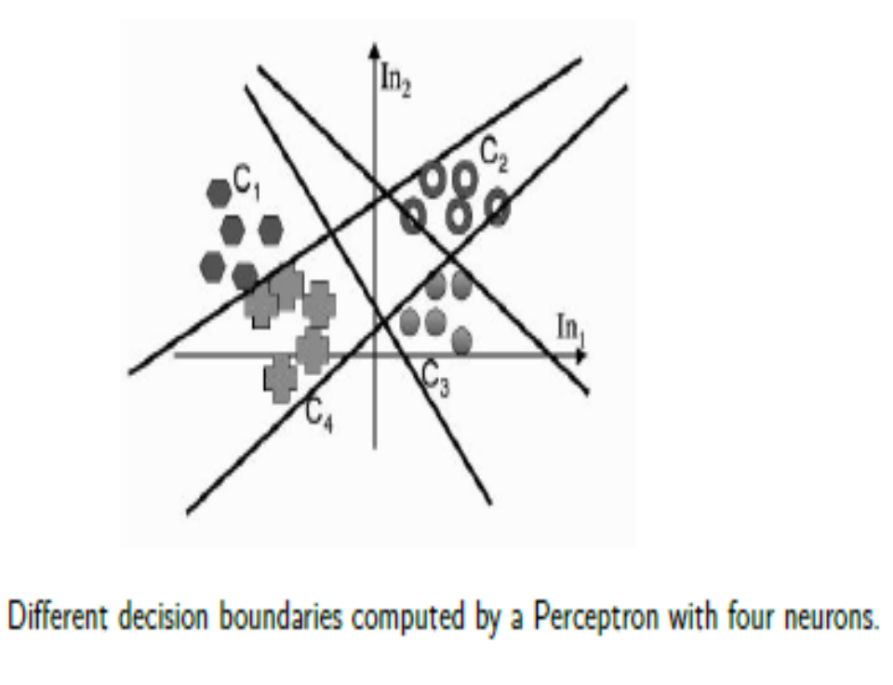
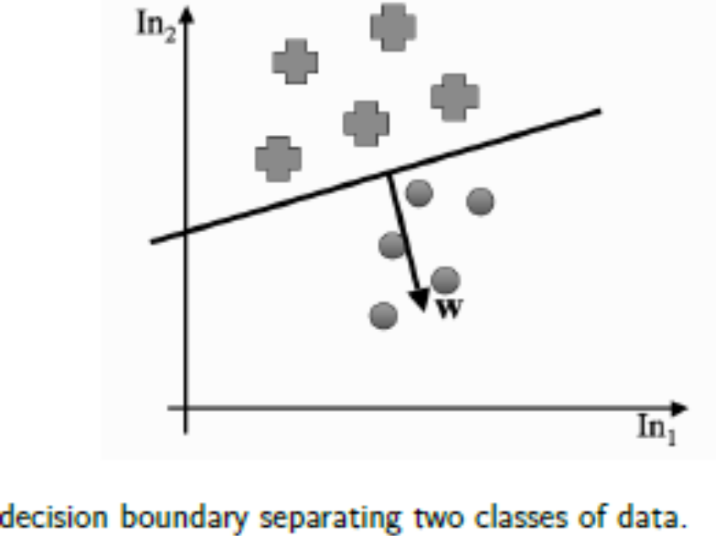

Slide 31
The Perceptron Convergence Theorem
Perceptron will converge to a solution that separates the classes, and that it will do it after a finite number of iterations.
In fact, the number of iterations is bounded by 1/ a , where a is the distance between the separating hyper plane and the closest data point to it.
We will assume that the length of every input vector |x| <1, although it isn’t strictly necessary provided that they are bounded by some constant R.

Slide 32
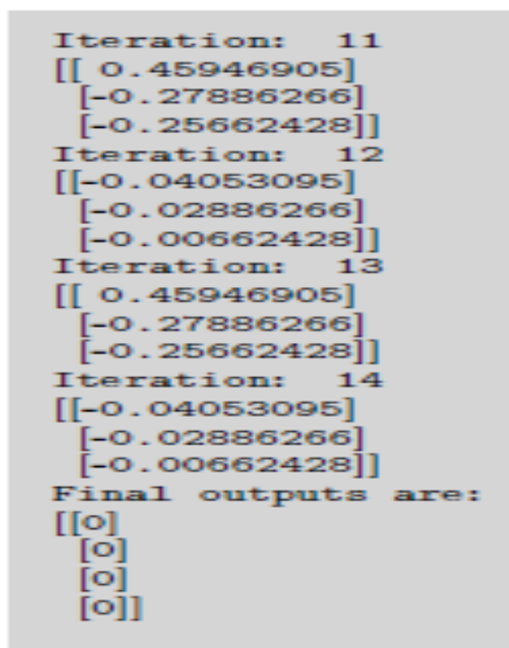
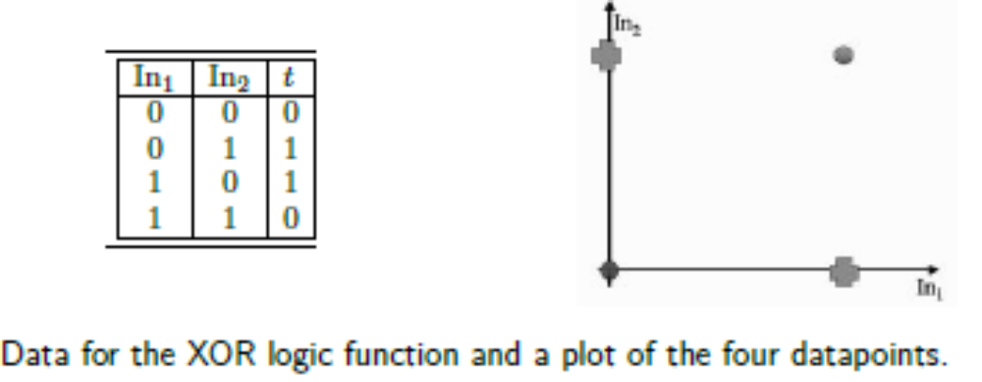
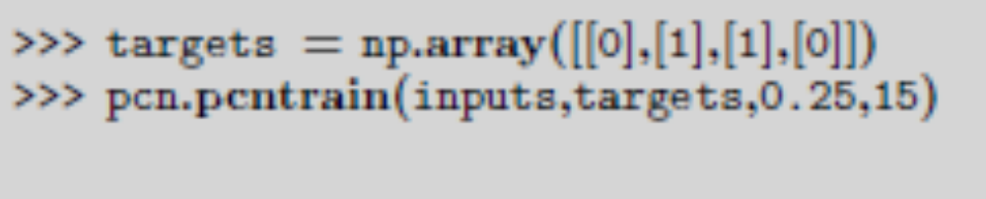
The Exclusive Or (XOR) Function

Slide 33
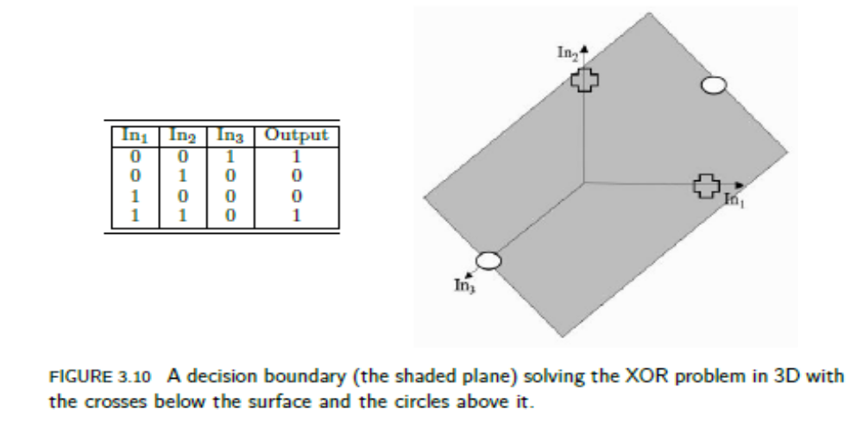
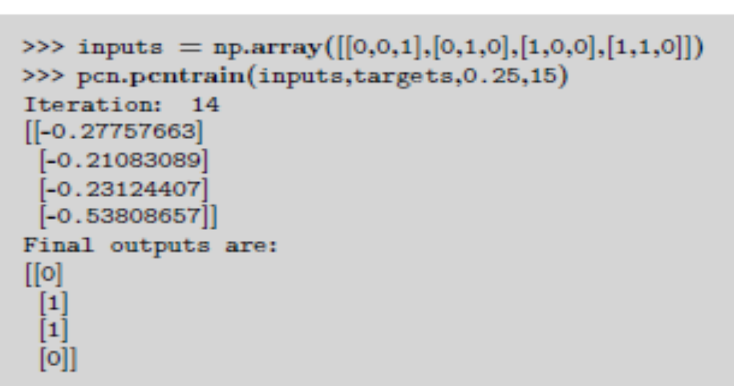
Kernal classifiers

Slide 34
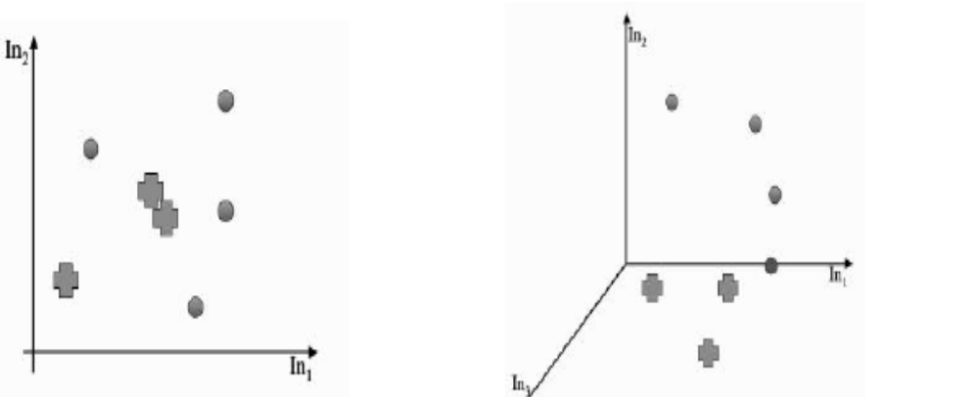
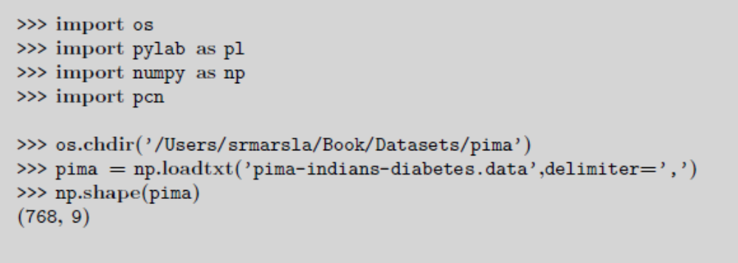
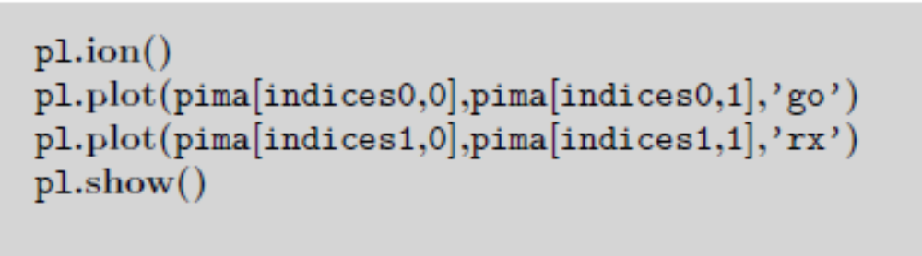

Slide 35
